Slide 1


Making A Song In Sonic Pi

Slide 2
Learning Objectives
Getting started with live_loop functions
Adding a drum beat, snare and hi-hat to your song
Changing the synth of your song
Changing the length of the notes by use of attack and release options
Adding a lead track
Adding randomization to your song

Slide 3
Making a song
This chapter focuses on creating a drum beat and getting to know the live_loop. One will learn how to add a bass track and finish the song by adding a melody. Adding lead tracks and randomization are also discussed.
We will create a simple drum beat, consisting of a kick drum, snare and hi-hat.
Drum Beats
We will earn about two things: live_loop and sample.
  Live_loop is live_loop is an endless repeating loop that can be synchronized with other live_loops.
  It is recommended that loops be named for easy identification. To name a live_loop, type live_loop followed by a full colon and then the name. It can be called anything. Our live_loop here is called drums.
  A live_loop has to have at least one sleep as shown in the example below:
live_loop :drums do
sample :drum_heavy_kick
sleep 1
end
Hit run to hear your live_loop.

Slide 4
Adding a snare
Let’s create a simple backbeat with kick drum on sample 1 and 3 and snare on sample 2 and 4.
use_bpm 100
live_loop :drums do
sample :drum_heavy_kick
sleep 1
sample :drum_snare_hard
sleep 1
sample :drum_heavy_kick
sleep 1
sample :drum_snare_hard
sleep 1
end
Note: To change the tempo of the beats above, just increase or decrease the bpm value.
The :drums loop starts with a kick, plays snare on the two, kick on three, then a snare on the four. Then the loop starts again as shown in the image in the next slide:

Slide 5
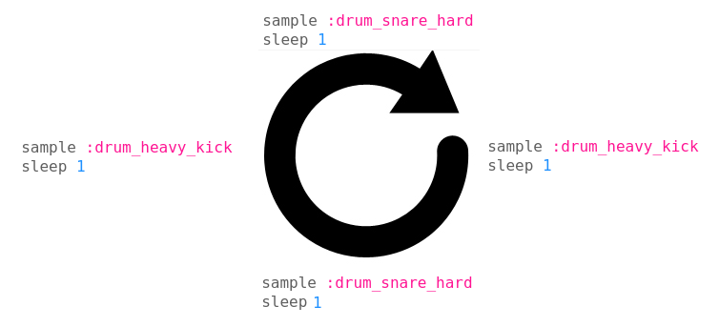
Making a song

Slide 6
Adding a hi-hat to your song
Create another live loop called :hihat and add your hi-hat samples to your code so to look like below:
use_bpm 100
live_loop :drums do
sample :drum_heavy_kick
sleep 1
sample :drum_snare_hard
sleep 1
sample :drum_heavy_kick
sleep 1
sample :drum_snare_hard
sleep 1
end

Slide 7
Adding a hi-hat to your song
live_loop :hihat do
sample :drum_cymbal_closed
sleep 0.25
sample :drum_cymbal_pedal
sleep 1
end

Slide 8
Bass track
Add another live loop for your bass and compose a solid and simple bass groove:
live_loop :bass do
play :c2
sleep 0.25
play :c2
sleep 2
play :e2
sleep 0.75
play :f2
sleep 1
end

Slide 9
Changing the synth
The default synth for sonic pi is called beep. To use a different synth, add the code use_synth :name_of_synth above the sequence of code e.g.
live_loop :bass do
use_synth :fm
play :c2
sleep 0.25
play :c2
sleep 2
play :e2
sleep 0.75
play :f2
sleep 1
end
To find more synths, click on the help icon at the top of the screen so that the help documents window appears. Then select Synths from the tabs along the left hand side of the help window. Click on any of the synth names to get more information on how to use it.

Slide 10
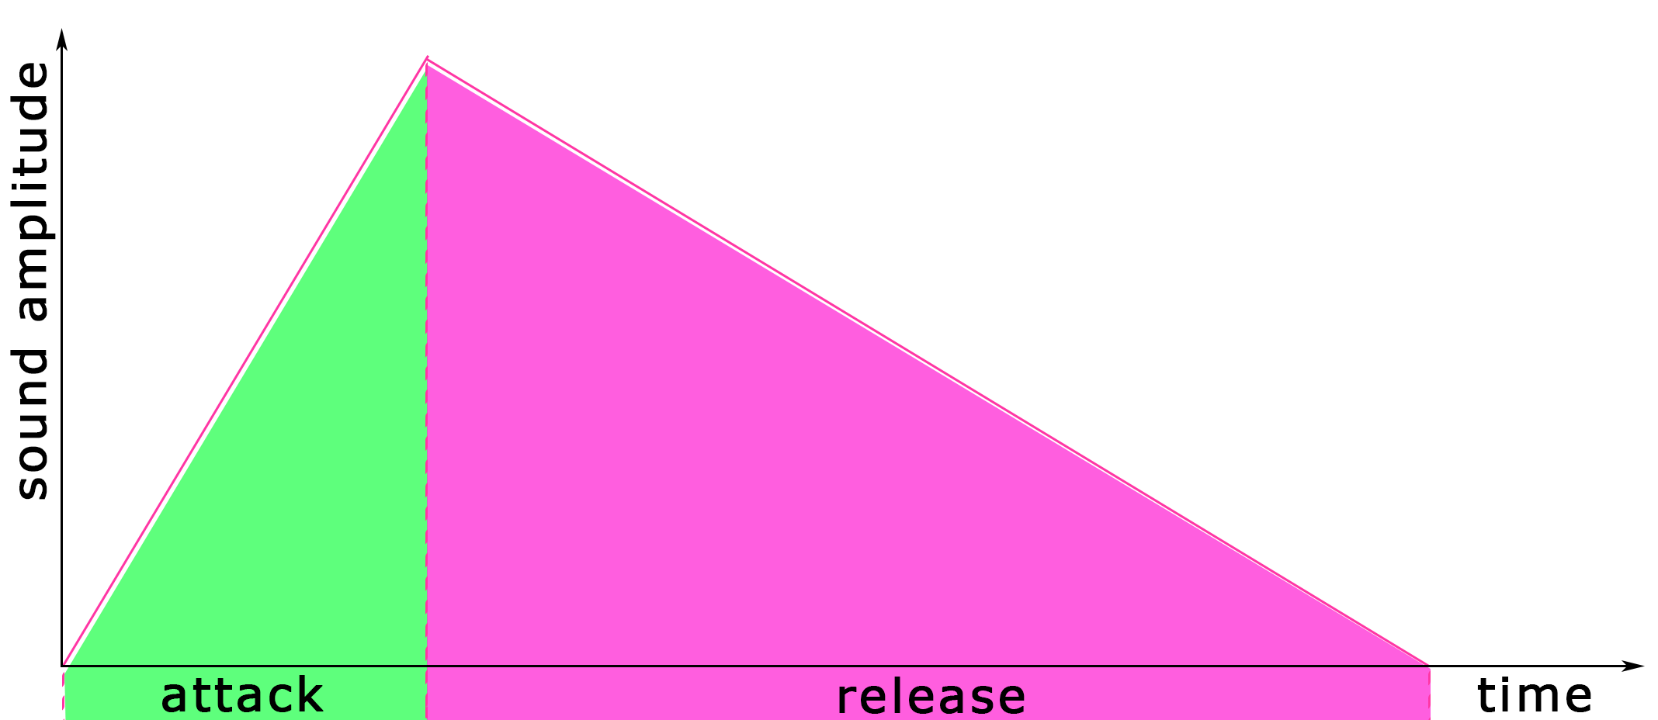
Changing the length of notes (attack and release options)
Occasionally, you might like to make sounds play longer or at a different rate. This can be achieved by modifying the optional parameters of the code you are using. attack and release control the amplitude of a note over time:
Using attack and release looks like the following.
play 60, attack: 1, release: 3. Now the note would be 4 beats long.
You could make a short staccato note by setting attack to zero and release to a very short value:
play :c4, attack: 0, release: 0.2

Slide 11
Attack and release options
If you don’t want to set your ops for each play or sample on your loop, just use use_synth_defaults and use_sample_defaults to set the opts for all the next plays and samples in the loop. Example:
live_loop :melody do
use_synth :mod_fm
use_synth_defaults attack: 0.25, release: 0.5, pan: rrand(-0.5, 0.5), cutoff: 50
play 72
sleep 0.25
play 76
sleep 0.25
play 76
sleep 0.25
end

Slide 12
Adding a lead track
Adding a lead track is simply adding a melody. Instead of writing so many repeated lines of play and sleep, we’re going to use a shortcut: play_pattern_timed.
Instead of writing:
play :c2
sleep 0.5
play :d2
sleep 0.25
play :e2
sleep 0.75
play :d2
Sleep 0.5
Just write them in one line as lists:
  play_pattern_timed [:c2, :d2, :e2, :d2], [0.5, 0.25, 0.75, 0.5]
The first list [:c2, :d2, :e2, :d2] is a group of notes and the second list [0.5, 0.25, 0.75, 0.5] is a group of breaks in between the notes.

Slide 13
Melody
Create a new live_loop called :melody to create a lead theme for your song. You can use play_pattern_timed function to write the melody if you understand it. See example:
live_loop :melody do
play_pattern_timed [:c4, :e4, :f4, :g4, :f4, :e4, :f4, :g4, :f4, :e4, :f4], [0.25, 0.25, 0.25, 1.5, 0.25, 0.25, 0.25, 0.25, 0.25, 0.25]
end
Now the whole song could be something like below:

Slide 14
Melody
use_bpm 120
Live_loop :drums do
sample :drum_heavy_kick
sleep 1
sample :drum_snare_hard
sleep 1
sample :drum_heavy_kick
sleep 1
sample :drum_snare_hard
sleep 1
end

Slide 15
Melody
live_loop :hihat do
sample :drum_cymbal_closed
sleep 0.25
sample :drum_cymbal_pedal
sleep 1
end

Slide 16
Melody
live_loop :bass do
use_synth :fm
play :c2, attack: 0, release: 0.25
sleep 0.25
play :c2, attack: 0, release: 0.3
sleep 2
play :e2
sleep 0.75
play :f2
sleep 1
end

Slide 17
Melody
live_loop :melody do
play_pattern_timed [:c4, :e4, :f4, :g4, :f4, :e4, :f4, :g4, :f4, :e4, :f4], [0.25, 0.25, 0.25, 1.5, 0.25, 0.25, 0.25, 0.25, 0.25, 0.25], attack: 0, release: 0.2
end
Exploring with different melodies, synths and attack: and release: values is always encouraged.

Slide 18
Adding randomization
Transposing the melody
Transposing means changing the pitch up or down. We can randomly transpose the melody a bit every now and then to add some spice to the track. See the example:
live_loop :melody do
if one_in(6)
use_transpose 2
else
use_transpose 0
end
play_pattern_timed [:c4, :e4, :f4, :g4, :f4, :e4, :f4, :g4, :f4, :e4, :f4], [0.25, 0.25, 0.25, 1.5, 0.25, 0.25, 0.25, 0.25, 0.25, 0.25], attack: 0, release: 0.2
end

Slide 19
Creating a random acid bass track
.choose is a handy method that randomly picks out an element from a list.
For example:
play [:c, :e, :g].choose
[:c, :e, :g] is a list of notes (in this case the notes of the C major chord). .choose picks out one of those notes at random.
Instead of notes you could have anything in the list. Like sleep values for example:
loop do
use_octave [0, 1].choose
play [:c, :e, :g].choose
sleep [0.25, 0.25, 0.5, 1].choose
end

Slide 20
Creating a random acid bass track
It is not important to remember what notes are in what chords because Sonic Pi can handles it. Instead of writing [:c, :e, :g], you can just use (chord :C, :major).
That creates a list of right notes for you automatically. Here’s an example:
loop do
play (chord :c, :major).choose
sleep [0.25, 0.25, 0.5, 1].choose
end

Slide 21
Sources and References
http://sonic-pi.mehackit.org/exercises/en/01-introduction/01-introduction.html
http://sonic-pi.net/

